Slide 1


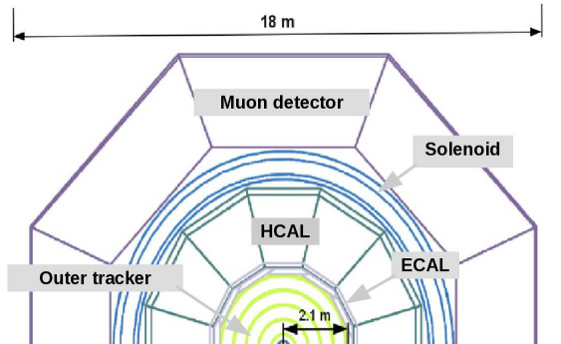
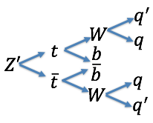
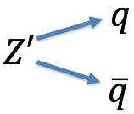
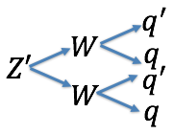
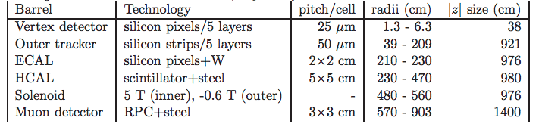
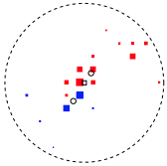
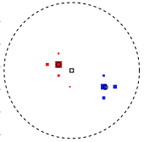
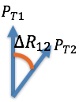
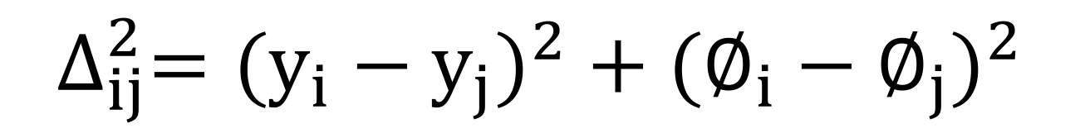
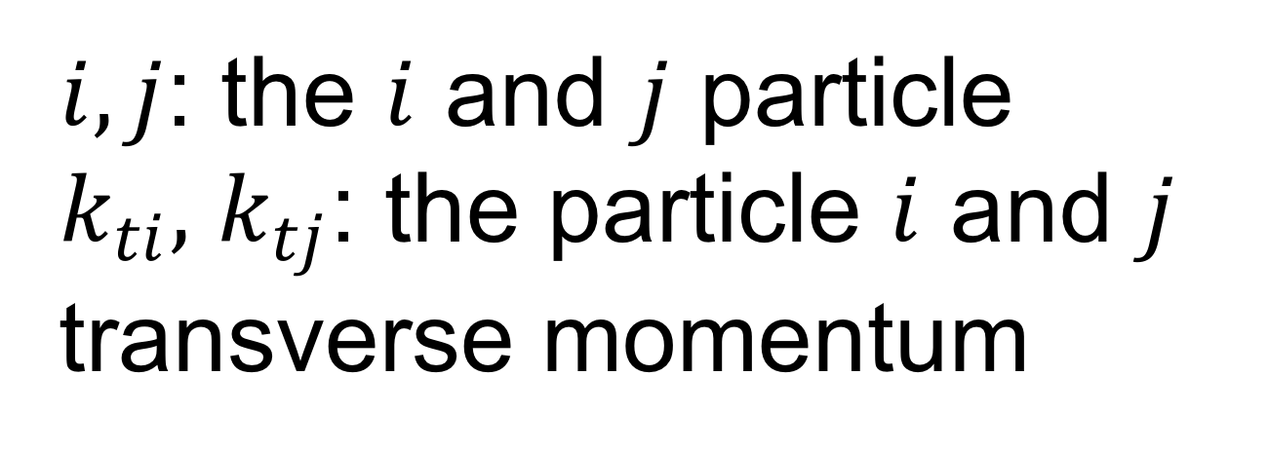



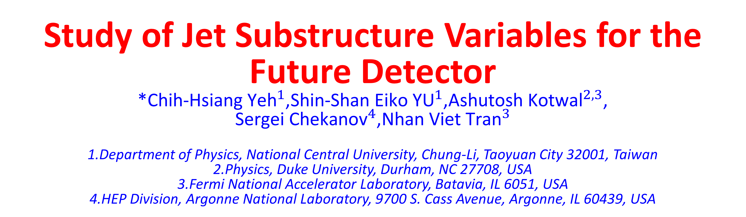
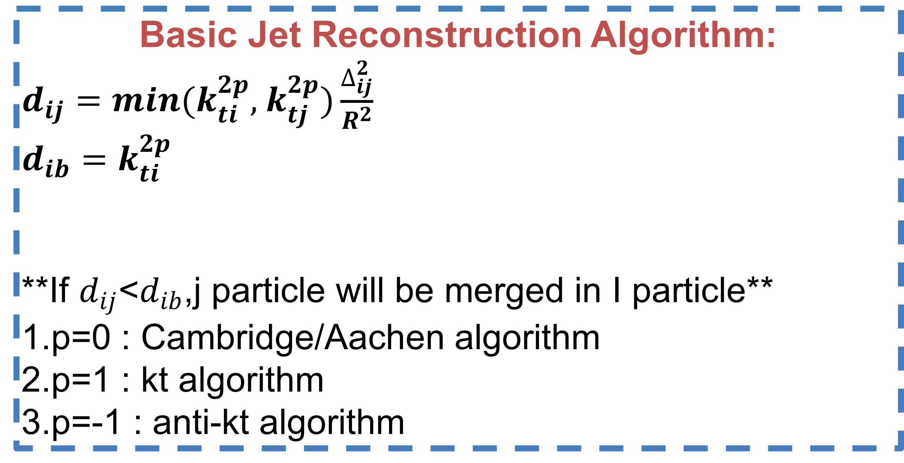


Study of Jet Substructure Variables for the Future Detector
*${\text{Chih}\text{−}\text{Hsiang} \text{Yeh}}^{1}$,${\text{Shin}\text{−}\text{Shan} \text{Eiko} \text{YU}}^{1}$,${\text{Ashutosh} \text{Kotwal}}^{2,3}$, ${\text{Sergei} \text{Chekanov}}^{4}$,${\text{Nhan} \text{Viet} \text{Tran}}^{3}$
1.Department of Physics, National Central University, Chung-Li, Taoyuan City 32001, Taiwan
2.Physics, Duke University, Durham, NC 27708, USA 3.Fermi National Accelerator Laboratory, Batavia, IL 6051, USA 4.HEP Division, Argonne National Laboratory, 9700 S. Cass Avenue, Argonne, IL 60439, USA
Abstract:
In this poster, we study the performance of hadron calorimeter in SiFCC for the future √s=100 TeV pp collider. The GEANT4 full simulation includes calorimeters with different cell sizes. We aim to efficiently separate signal Z’->ww or Z’->tt and background Z’->qq. Various jet substructure variables and Z’ masses from 5 to 40 TeV are also compared.
Signal and QCD Background Process:
Geant 4 Simulation of Future Detector SiFCC
ˋ
QCD Background:
Signal:
Variables Study in Cluster:
Distribution of z’->ww,z’->qq and z’->tt,z’->qq :
Basic Jet Reconstruction Algorithm:
$d_{ij}=min(k_{ti}^{2p},$ $k_{tj}^{2p})\frac{∆_{ij}^{2}}{R^{2}}$
$$d_{ib}=k_{ti}^{2p}$$
**If $d_{ij}$<$d_{ib}$,j particle will be merged in I particle**
1.p=0 : Cambridge/Aachen algorithm
2.p=1 : kt algorithm
3.p=-1 : anti-kt algorithm
Study of the variables in different detector size:
$$∆_{ij}^{2}=({y_{i}−y_{j})}^{2}+{(∅_{i}−∅_{j})}^{2}$$
$i,j$: the $i$ and $j$ particle
$k_{ti},$ $k_{tj}$: the particle $i$ and $j$ transverse momentum
Summary for clustering:
1. In variable$C_{2}^{1}$, the ROC curves of the three detector cell sizes are close to each other for each collision energy . Therefore, this variable is not sensitive to the detector cell size.
2. In $τ_{21}$, at 5 TeV, the smallest detector size can separate the background from the signal well. However, this is not the usual case as the ROC curves nearly merge together at higher collision energy.
3. In $τ_{32}$, the smallest detector size has the best separation power for all collision energies.
Jet Substructure Variables:
1.N-subjetness:
$τ_{N}=\frac{1}{d_{0}}\sum_{k}{P_{t,k} min\{∆R_{1,k},∆R_{2,k}…∆R_{N,k}\}}$
${ d}_{0}=\sum_{k}{P_{t,k}R_{0}}$
$∆R_{i,k}:$
$R_{0}:The cone size we want to cluster$
$τ_{21}=\frac{τ_{2}}{τ_{1}},$ $τ_{32}=\frac{τ_{3}}{τ_{2}}$
2.Energy correlation function
$$ECF\left(N,β\right)=\sum_{i_{1}<i_{2}<..<i_{N}∈J}{(\prod_{a=1}^{N}{PT_{ia}){(\prod_{b=1}^{N−1}{\prod_{c=b+1}^{N}{∆R_{ibic}}})}^{β}}}$$
$C_{N}^{(β)}≡$ $\frac{ECF\left(N+1,β\right)ECF(N−1,β)}{{ECF(N,β)}^{2}}$
3.Soft drop:
$$\frac{min(P_{T1,}P_{T2})}{P_{T1}+P_{T2}}<Z_{cut}{(\frac{∆R_{12}}{R_{0}})}^{β}$$
$$β>0:Remove \left(soft\right), maintain\left(soft−collinar\right)$$
$$β=0:Depend on the cut to select the asymmetry$$
$$β<0:Remove both \left(soft\right)and (collinear)$$
Study of Soft Drop:
$$P_{T1}$$
Study of the soft drop in different detector size:
$$R_{12}$$
$$P_{T2}$$
Summary for soft drop :
Fix central
Fix width
Reference :
AN-2015-186 (CMS internal analysis note)

Slide 2

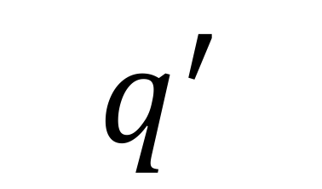



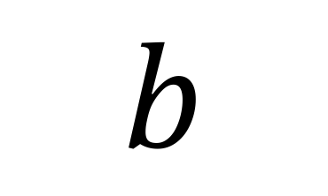
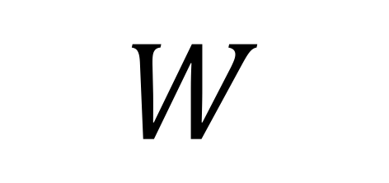

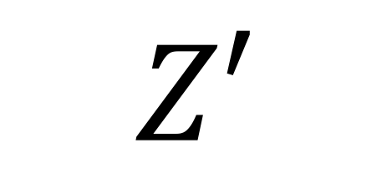
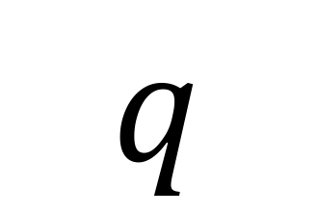
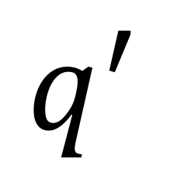
$$q^{′}$$
$$W$$
$$q$$
$$Z′$$
$$t$$
$$b$$
$$\overline{b}$$
$$\overline{t}$$
$$W$$
$$q$$
$$q^{′}$$

